Slide 1

C++ & DSA PLACEMENT COURSE
Khaiser Khanam

Slide 2

TIME COMPLEXITY CALCULATION GUIDE AND PRACTICE PROBLEMS

Slide 3
1. Drop Non-Dominant Terms
When you have multiple terms, keep only the term that grows the fastest
Example: O(n² + n) → O(n²)
Example: O(n³ + n² + n) → O(n³)

Slide 4
2. Drop Constant Factors
Remove constant multipliers as they don't affect asymptotic growth
Example: O(3n) → O(n)
Example: O(1/2 · n²) → O(n²)

Slide 5
3. Break Code into Fragments
Analyze different sections of code separately
For sequential operations, add the complexities
For nested operations, multiply the complexities

Slide 6
4. Common Rules
Simple statements: O(1)
Single loops: O(n) where n is the loop variable's range
Nested loops: O(n×m) where n and m are the respective ranges
Logarithmic algorithms (like binary search): O(log n)

Slide 7
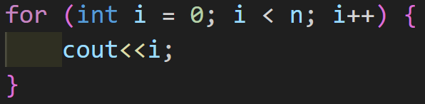
Problem Solving

Slide 8
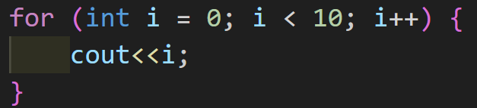
Problem Solving

Slide 9
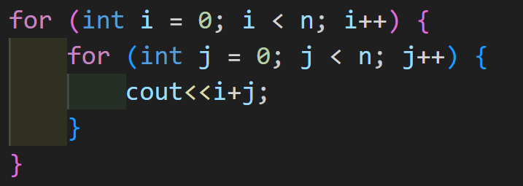
Problem Solving

Slide 10
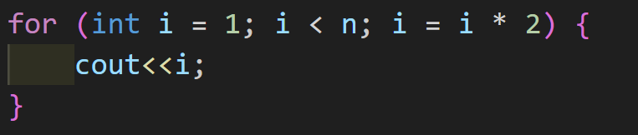
Problem Solving

Slide 11
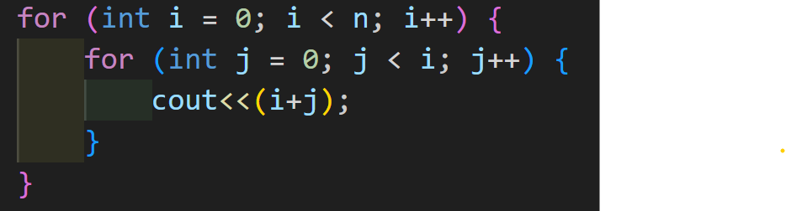
Problem Solving

Slide 12
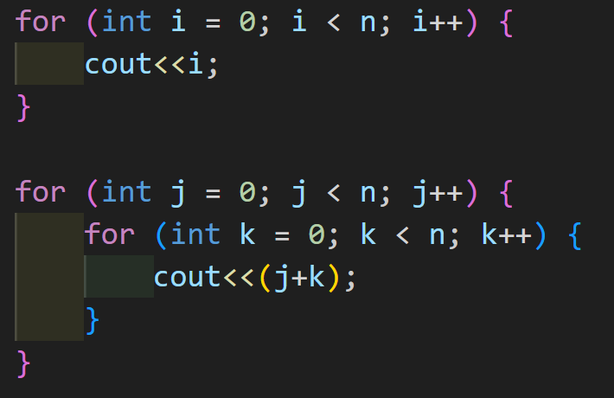
Problem Solving

Slide 13
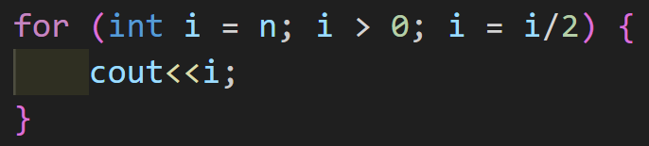
Problem Solving

Slide 14
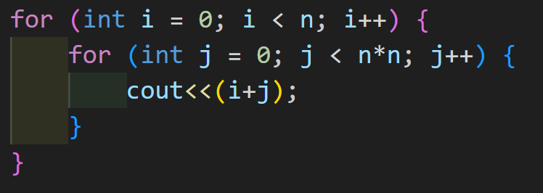
Problem Solving

Slide 15
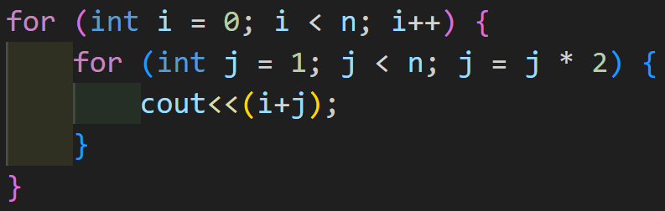
Problem Solving

Slide 16
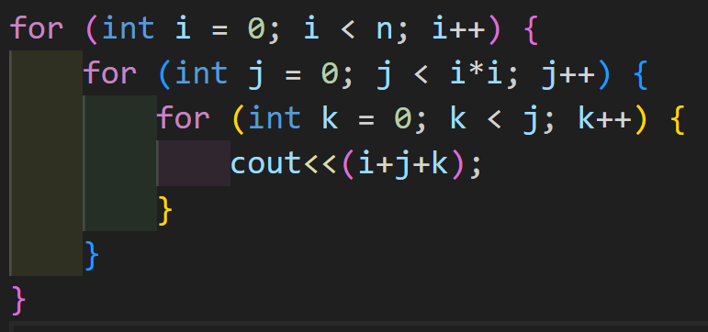
Homework

Slide 17
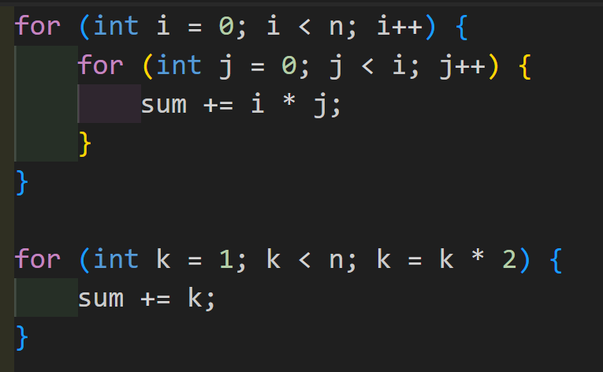
Homework

